Slide 1

WEB DEVELOPMENT – WEATHER API AND TRAIN TICKET RESERVATION SYSTEM
Project Supervisor: DR. C. GEETHA M.TECH., Ph.D.
Name of the Student: KIRAN M
Register Number: 41120094

Slide 2
Presentation Outline
Course Certificate
Abstract
Introduction
Objectives
Proposed System Architecture
Modules(List out all modules with description)
Proposed Algorithm
Results(Output Screenshot)
References

Slide 3

Course Certificate

Slide 4
Abstract
Weather API integration is a crucial component of modern web development, offering real-time and forecasted weather data to enhance user experiences and functionality.
The Train Ticket Reservation Web Development project aims to revolutionize the way passengers plan and book train journeys by providing an efficient and user-friendly online platform. This web application is designed to streamline the process of reserving train tickets, offering passengers a convenient and reliable means to access real-time train information, select seats, make secure payments, and manage their bookings.

Slide 5
Introduction
Weather APIs have become invaluable tools for developers and businesses seeking to provide accurate and timely weather information to their users. They enhance user experiences by helping people plan their activities, make informed decisions, and stay safe in various weather conditions.
Developing a train ticket reservation website requires a combination of frontend and backend technologies, security measures, and a deep understanding of the transportation industry's complexities. With proper planning and execution, such a website can provide travelers with a convenient and efficient way to book and manage their train journeys.

Slide 6
Objectives
The objectives of the Weather API web development project aims to create a valuable and user-friendly tool for accessing accurate weather information, helping users make informed decisions based on current and forecasted weather conditions.
Train Ticket Reservation System should prioritize ease of use, accessibility, real-time information, payment security, comprehensive user support to address the needs and expectations of today's travelers. The development of such a system will significantly contribute to the overall improvement of the transportation industry.

Slide 7
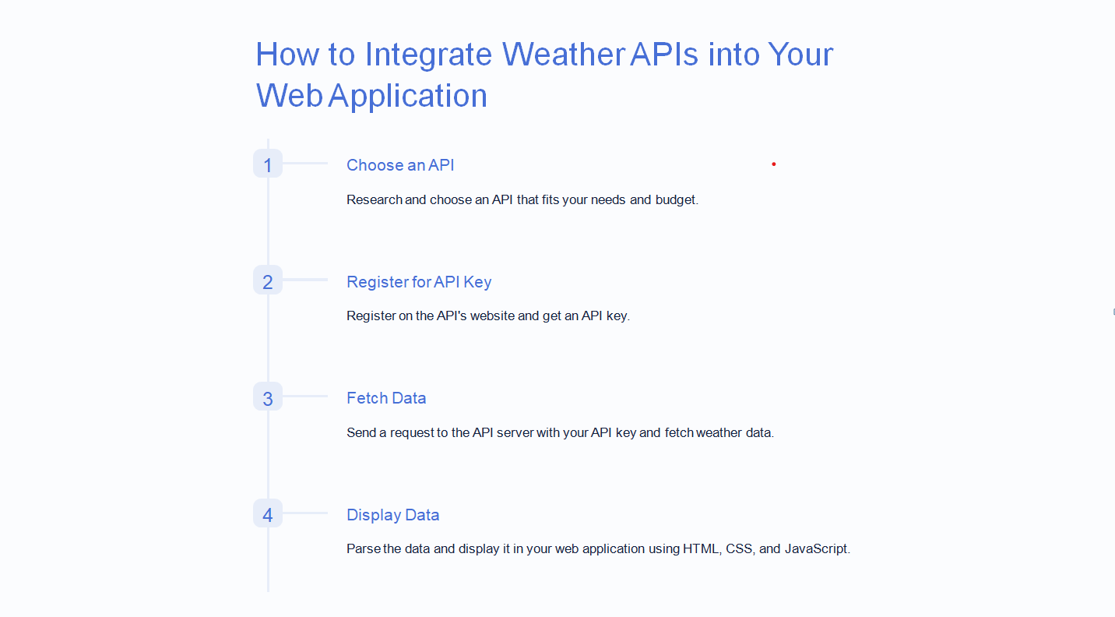
Proposed System Architecture

Slide 8
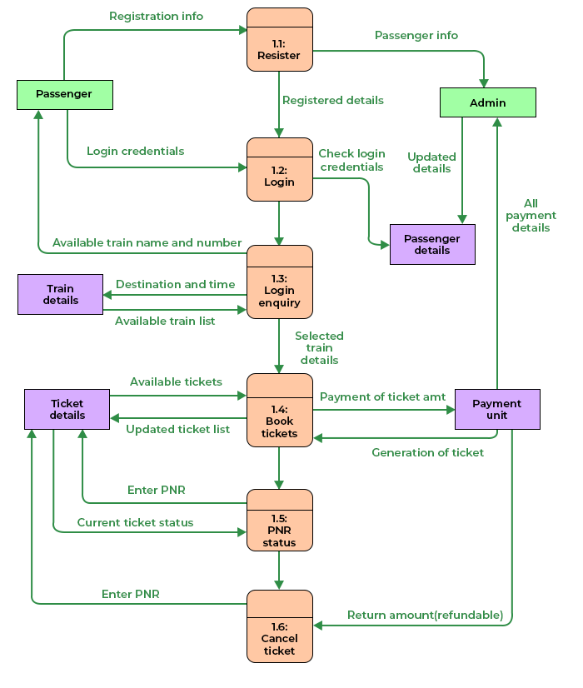
Architecture of Train ticket reservation system

Slide 9
Modules
Front end modules:
User Interface (UI):
HTML: use HTML to structure the webpage, defining elements like buttons ,text areas, and containers for displaying quotes.
CSS: Apply CSS styles for visual appeal, including fonts, colors, layout, and responsiveness for different devices and screen sizes.

Slide 10
JavaScript: implement java script to add interactivity to the UI .
PHP AND MYSQL: used to store the values in the databases by creating tables with respective table name and table header.

Slide 11
Homepage: This page provides the introduction of the project which will direct to the other pages like weather api, train ticket reservation system and about us page.
About Me: In this section, you can provide a more detailed biography, education, skills, and personal interests. It helps visitors get to know you better.

Slide 12
Proposed Algorithm
Obtain API Keys and Credentials:
Sign up for the selected weather API and train booking system to obtain necessary API keys and credentials for authentication.
Choose a suitable train booking API or service provider to integrate train-related functionalities.
Design the User Interface (UI):
Sketch the layout and design for weather display and train reservation components.
Plan user interactions, such as search forms, ticket selection, and weather location input.

Slide 13
Implement Backend Functionality:
Create API endpoints for weather data and train-related operations.
Implement logic to fetch weather data from the weather API using the API key.
Integrate the train booking API to handle train-related functionalities.
Implement Frontend Interface:
Develop responsive UI components for weather display and train reservation forms.
Implement API calls to fetch weather data and interact with the train booking API.

Slide 14
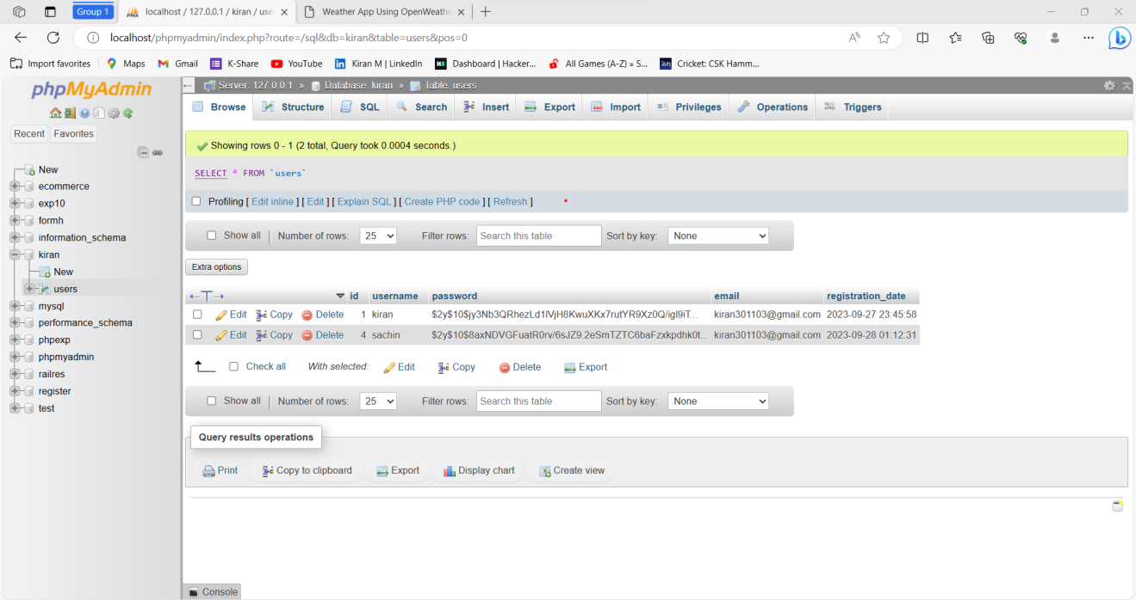
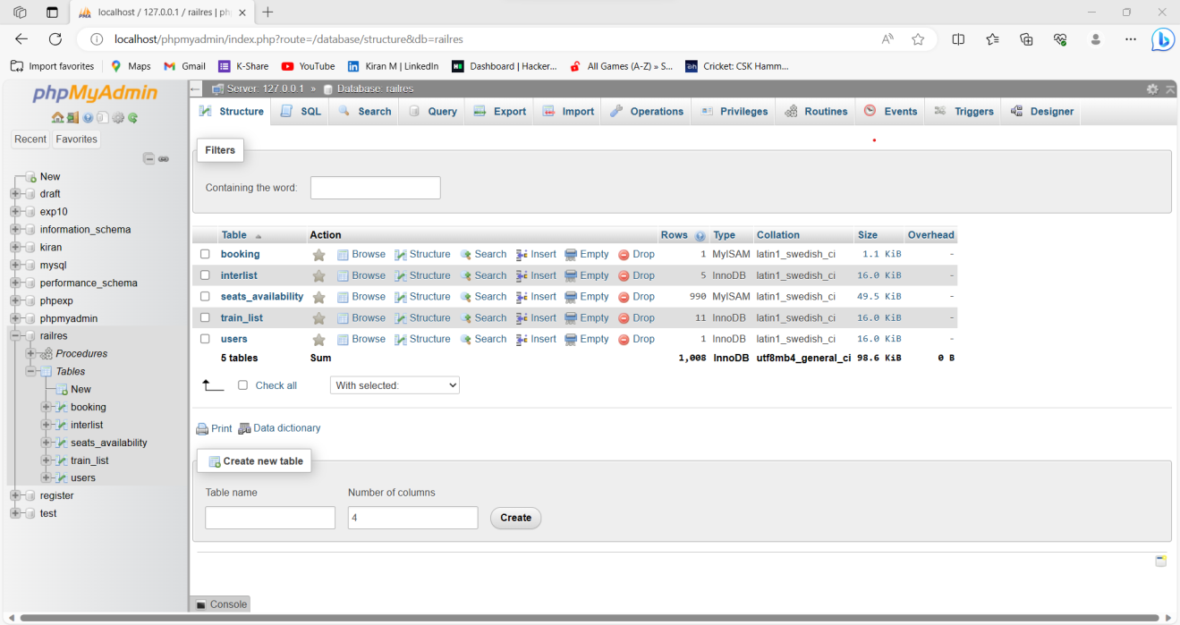
Results Creation of database and table

Slide 15
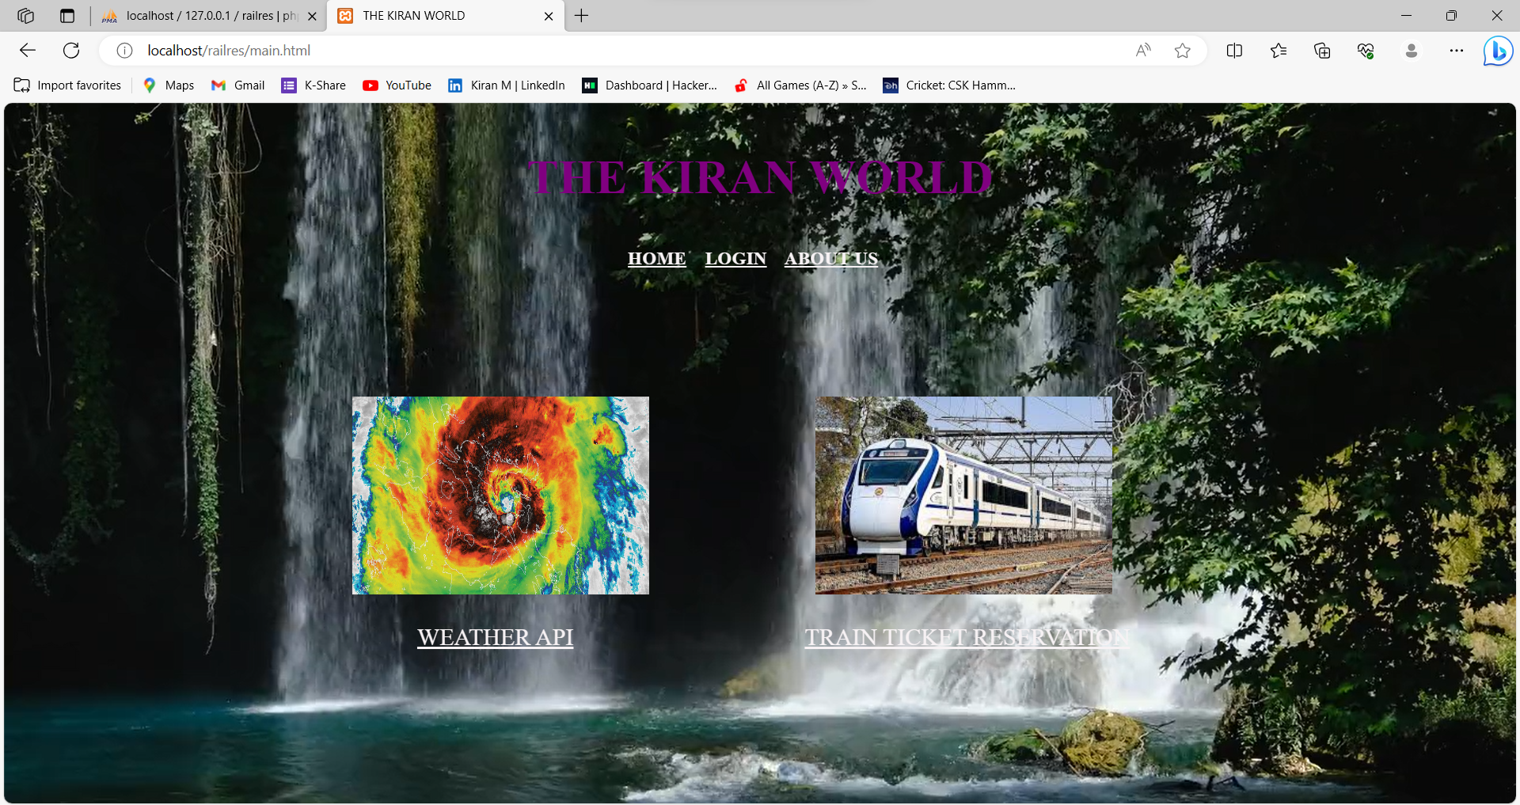
Home page

Slide 16
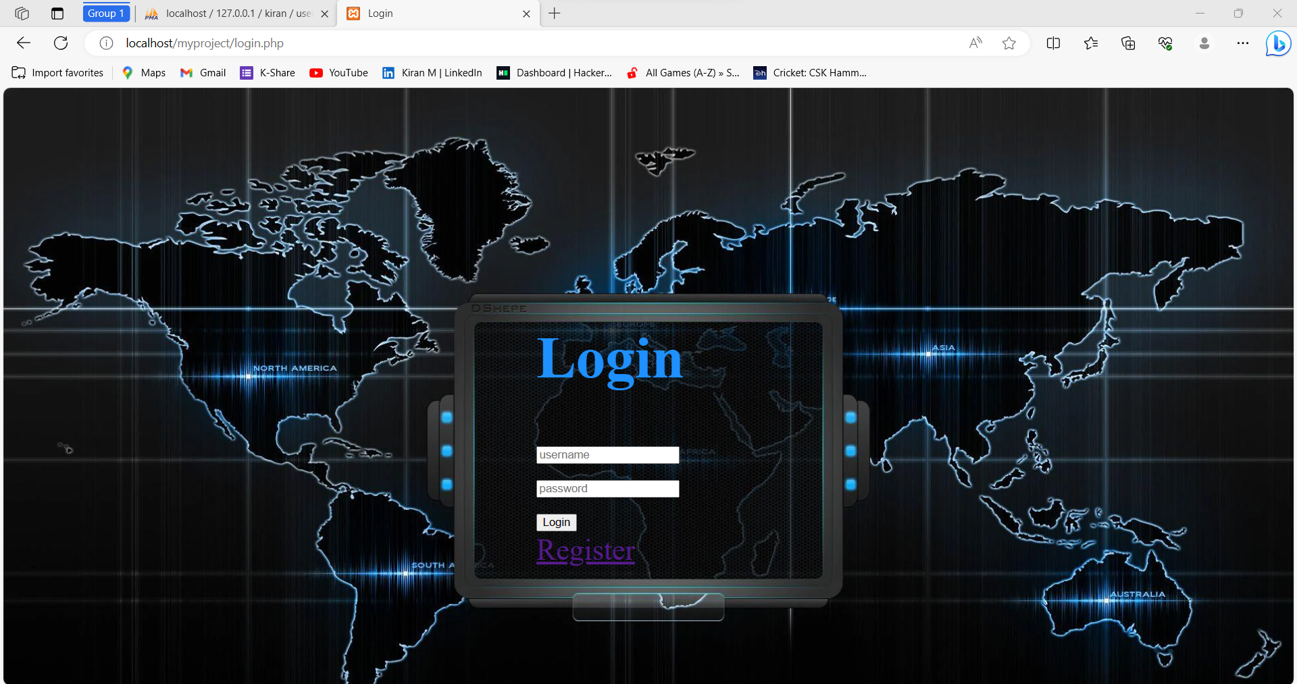
Login page for weather api

Slide 17
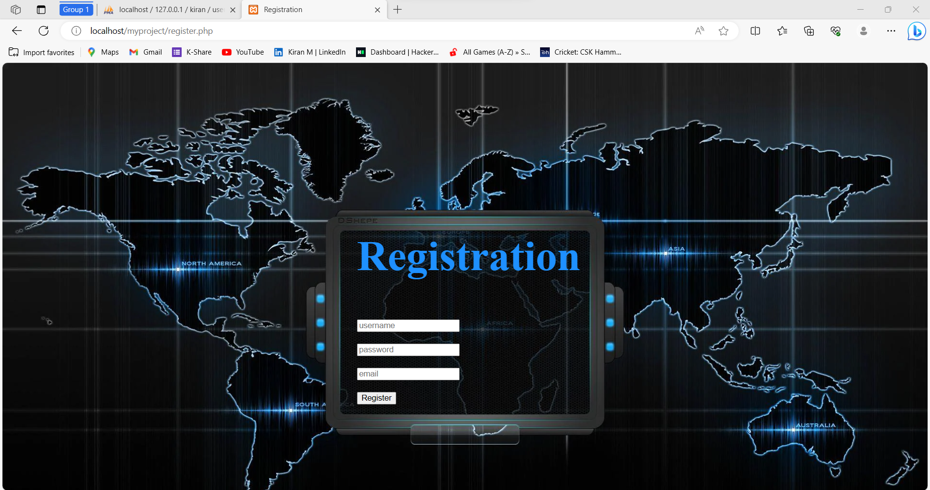
Registration page for weather api

Slide 18
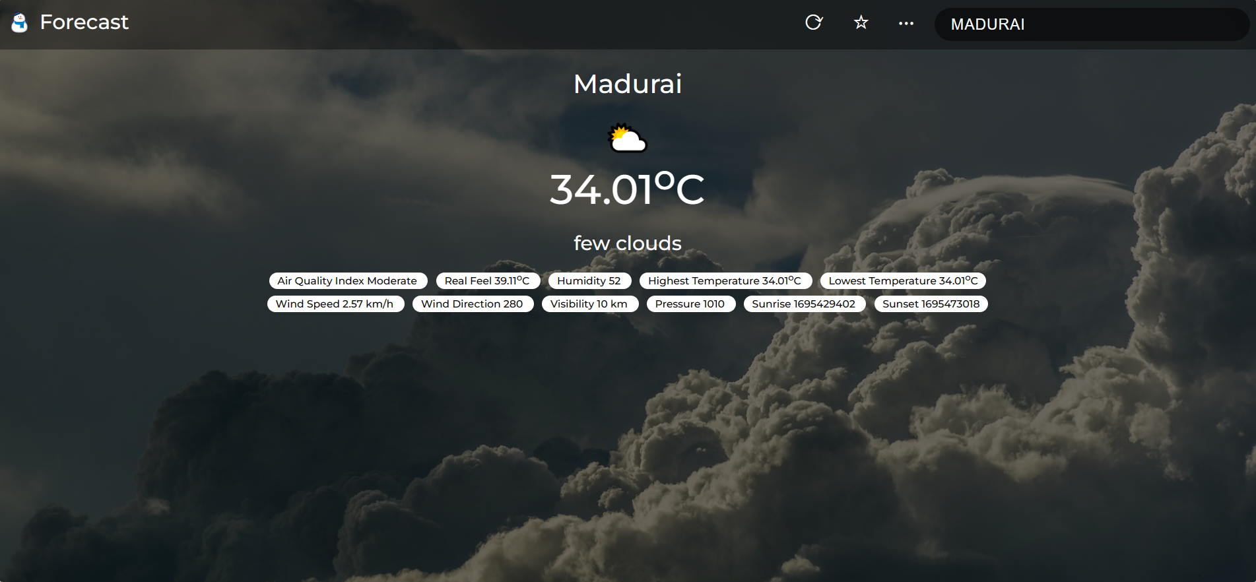
Output page of weather api

Slide 19
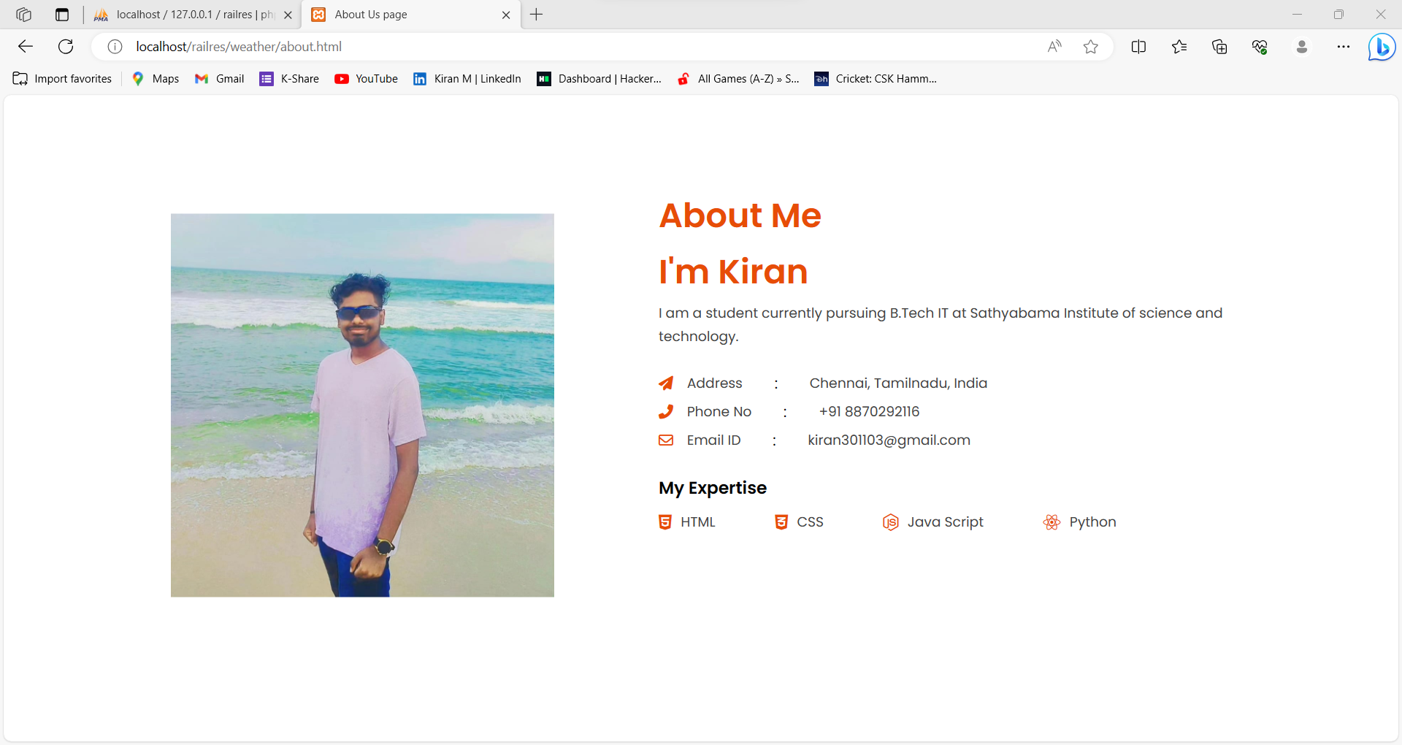
About page

Slide 20
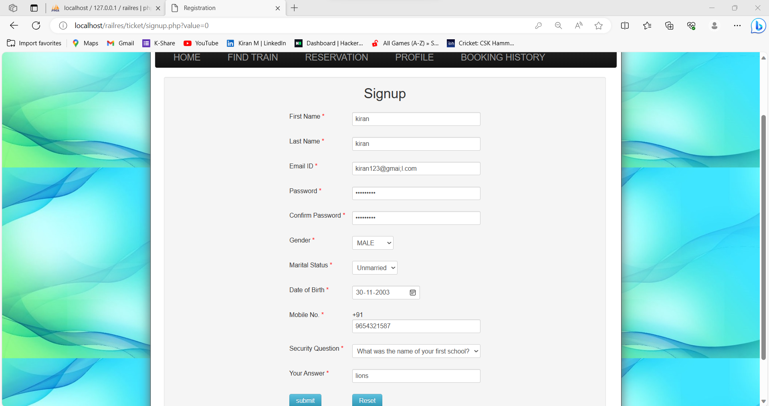
Signup page of train ticket reservation system

Slide 21
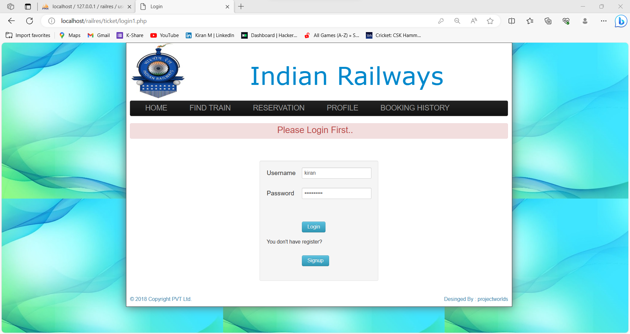
Login page of train ticket reservation system

Slide 22
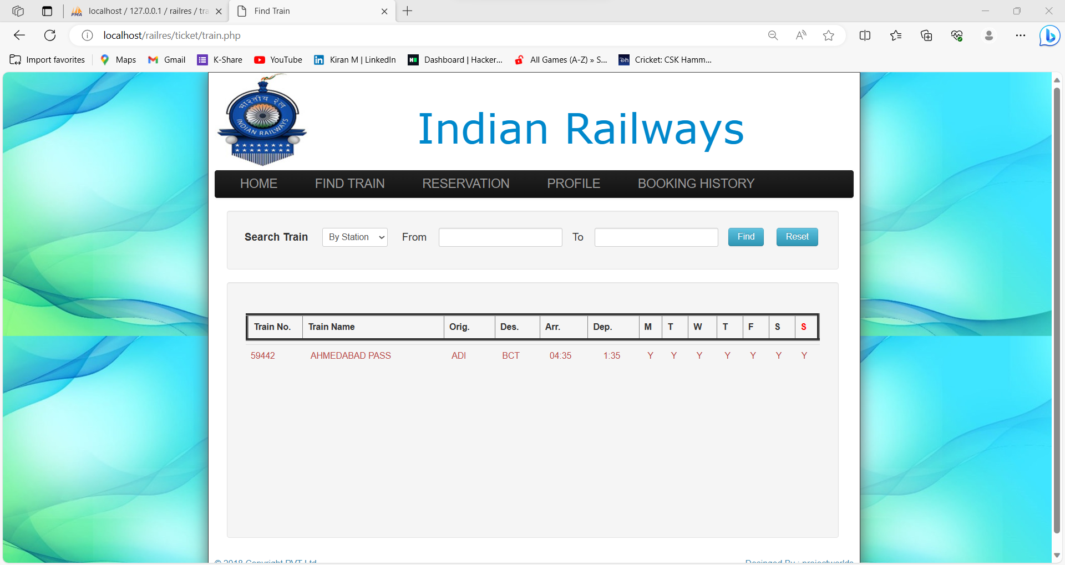
Finding train page

Slide 23
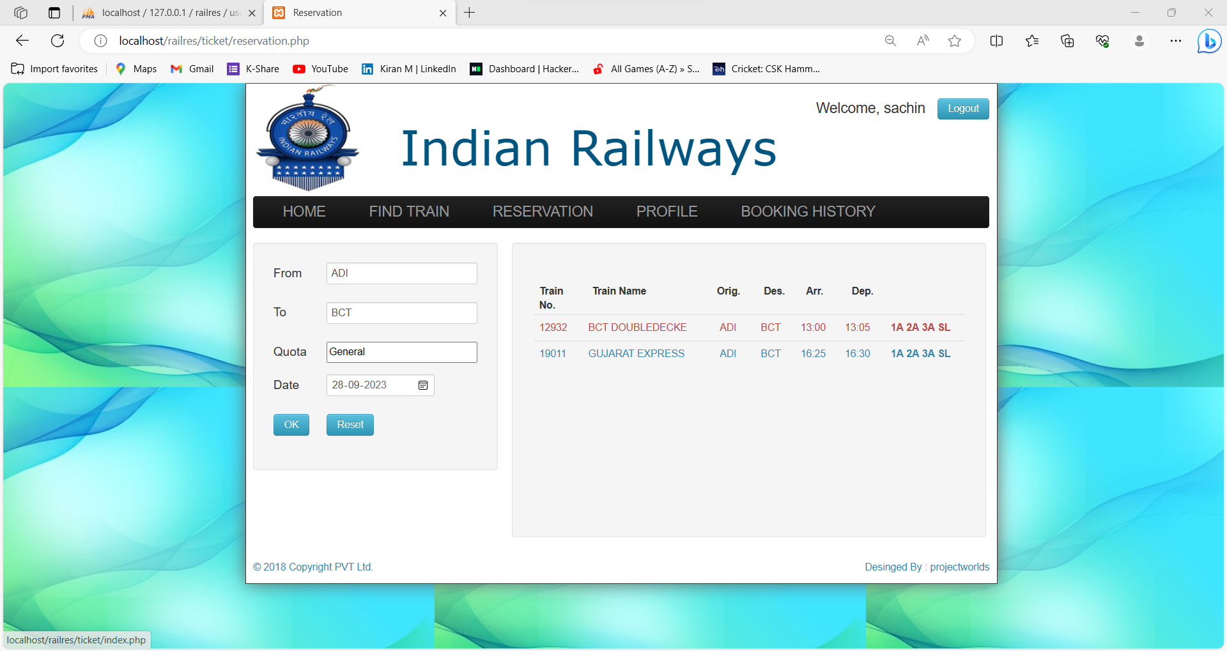
Ticket Reservation Page

Slide 24
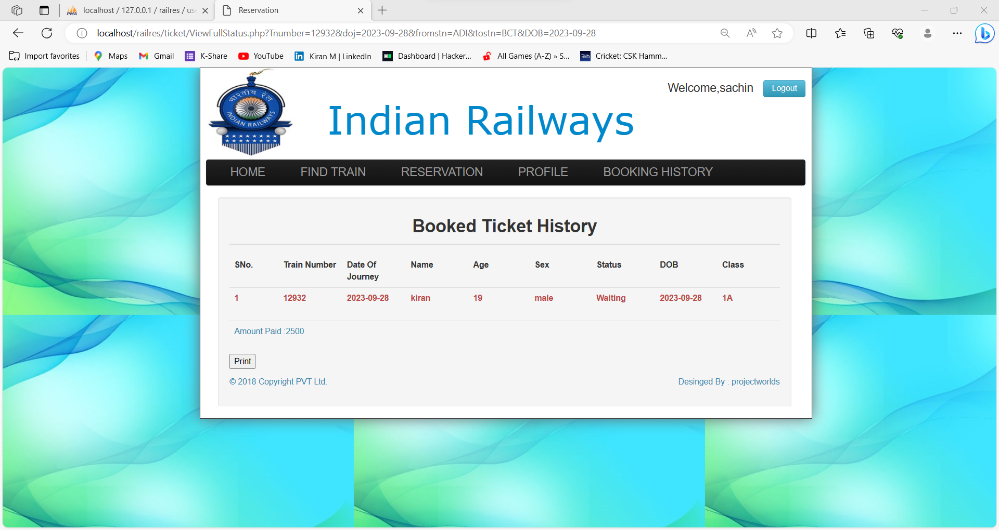
Booking History

Slide 25
References
https://en.wikipedia.org/wiki/OpenWeatherMap
https://www.windy.com/-Wind-gusts-gust?gust,12.985,80.041,8
https://www.indianrail.gov.in/enquiry/StaticPages/StaticEnquiry.jsp?StaticPage=index.html

